Slide 1
Chapter 5: HTML5 & Mobile Phones
HTML5 Video Series

Slide 2
HTML5 vs Native Apps
Compared to older versions of HTML, HTML5 makes it much easier to create full featured web applications that can be updated remotely with new functionality without requiring users to download and install an update each time.
HTML5 helps reduce the functionality gap between mobile sites and apps.
It is much cheaper to develop HTML5 mobile apps than it is to create native apps
HTML5 for mobile apps is catching on fast and some say will replace native mobile apps and the App Store
HTML5 Video Series

Slide 3
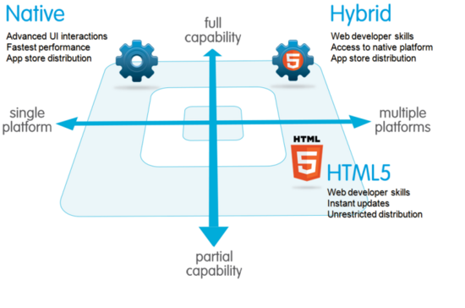
Hybrid Apps
A hybrid mobile app takes an HTML mobile app and inserts it inside a native wrapper
HTML5 Video Series
http://wiki.developerforce.com

Slide 4
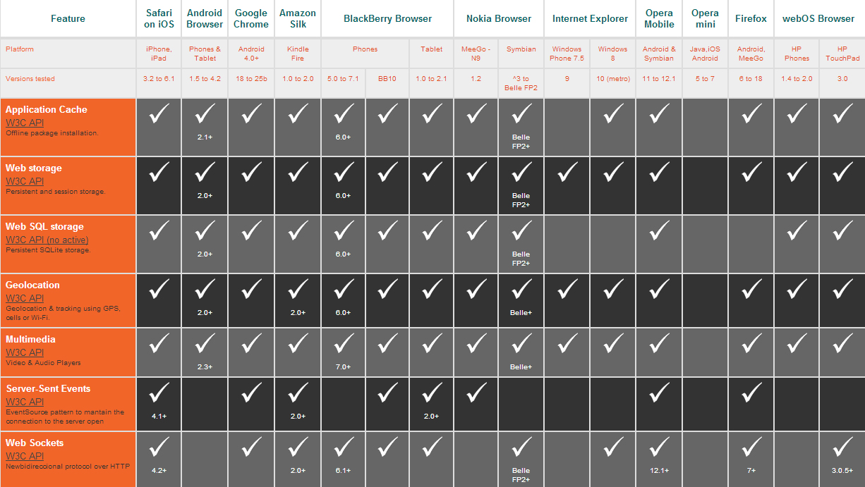
Mobile Browser Support 1
HTML5 Video Series
The table above is from mobilehtml5.org

Slide 5
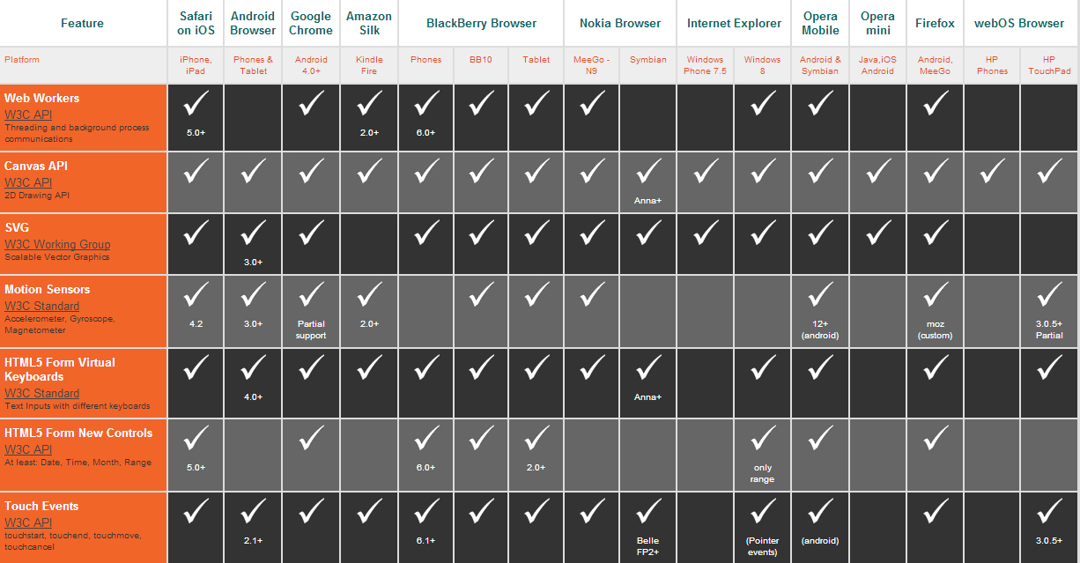
Mobile Browser Support 2
HTML5 Video Series
The table above is from mobilehtml5.org

Slide 6
Using Frameworks
Popular HTML5 Friendly Mobile Frameworks
Titanium
Sencha Touch
Sproutcore Touch
PhoneGap
HTML5 Video Series

Slide 7
Use Application Cache
If you are building an html5/native hybrid, you need to utilize AppCache because you will have an icon, splash screen and you want to be able to use it without connecting to the Internet
To do this, you need to use a server where you can change the HTTP headers on your files. You can use any Apache server and add something to the .htacess file
HTML5 Video Series

Slide 8
HTML5 Markup Layout
<html>
<head>
<meta name="viewport" content="user-scalable=no, width=device-width, initial-scale=1.0, maximum-scale=1.0"/>
<meta name="apple-mobile-web-app-capable" content="yes" />
<meta name="apple-mobile-web-app-status-bar-style" content="black" />
<link rel="apple-touch-icon" href="iphon_appname_icon.png"/>
<link rel="apple-touch-startup-image" href="startup.png" />
<link rel="stylesheet" href=“style.css" type="text/css" media="screen, mobile" title="main" charset="utf-8">
<title>Your App Title</title>
</head>
<body>
<!-- Put your Markup Here -->
<script type="text/javascript" src=“yourjavascript.js"></script>
</body>
HTML5 Video Series

Slide 9
Icons & Start Screens
For any kind of hybrid or native app, you need certain aspects to fit in with the other apps..
An Icon of specific size: iPhone icons should be 57px by 57px
Splash or Startup Screen: Should be 320px x 460px and should be in PNG or JPG format.
HTML5 Video Series

Slide 10
Congratulations!
HTML5 Video Series
You now know HTML5!

